Slide 1

OxiScience NonScents’ Sales & AdWord Spend Data Analysis Project Group 3 Roger André, Molly Gordon, Shilpi Mittal, Amanda Jaeger

Slide 2
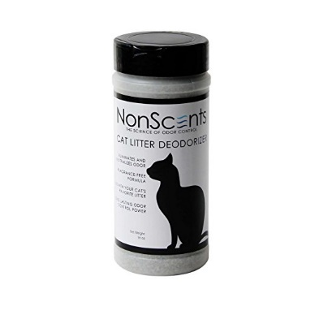

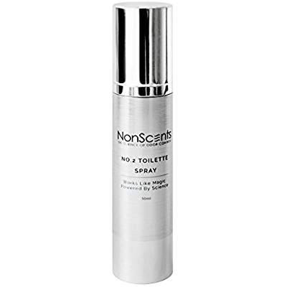
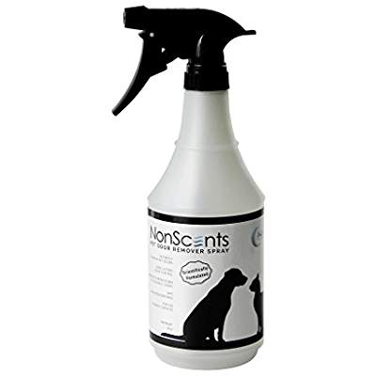
Facts about OxiScience NonScents?
Overview
Local startup founded in 2015
Specializing in kitty litter and other odor control products
7 products in 4 product groups
eCommerce sales channel - Amazon
Business Problem
Reporting currently done ad hoc in Excel
Lack insights on effectiveness of Google AdWords
No dedicated BA or data analyst

Slide 4


The Dataset
NonScents’ sales order and Google AdWords data for 7 products from July – early November 2017.
Sales Orders
AdWords
Date, Product Price, Qty, Shipping Address
Date, Cost, Clicks
Merged dataset
AdWords, Aggregate Revenue, Calculations

Slide 5
Ask Question(s)
Does Google AdWord spend have an impact on Sales?
Ask Questions
Wrangle Data
Explore Data
Draw Conclusion
Communicate Findings
Considerations
Timing (e.g. day of week)
Focus is on order fulfillment (revenue) and not order placement
Assumptions:
AdWord payment for clicks
Item price = revenue

Slide 6
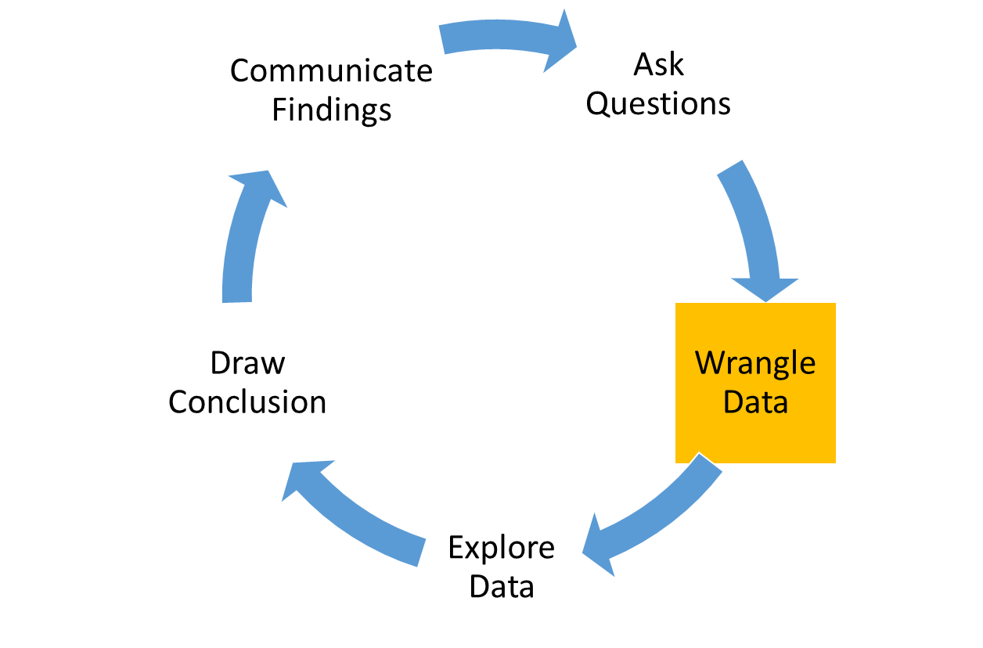
Wrangle Data
Select Columns
Set Data Types
Perform Calculations
Currency conversion (CAD → USD)
Revenue and Quantity aggregate
Clean Data
Remove sample orders ($0 item price)
Narrowed dataset from 35 to 14 columns
Reviewed each column in our datasets to determine which were useful for our analysis
Join Data
Address outliers (“Shipping” status)
Convert date fields to common format with YMD
Product name mapping*
Rename to meaningful column names
Merge sales (aggregate) and AdWord datasets
Perform additional calculations on merged data
Join on Date
Identify and set categorical data (e.g. Status, Product, Country)
Derive day of week, week #, month
Verify Item Price factors in Qty
Filter cancelled orders

Slide 7
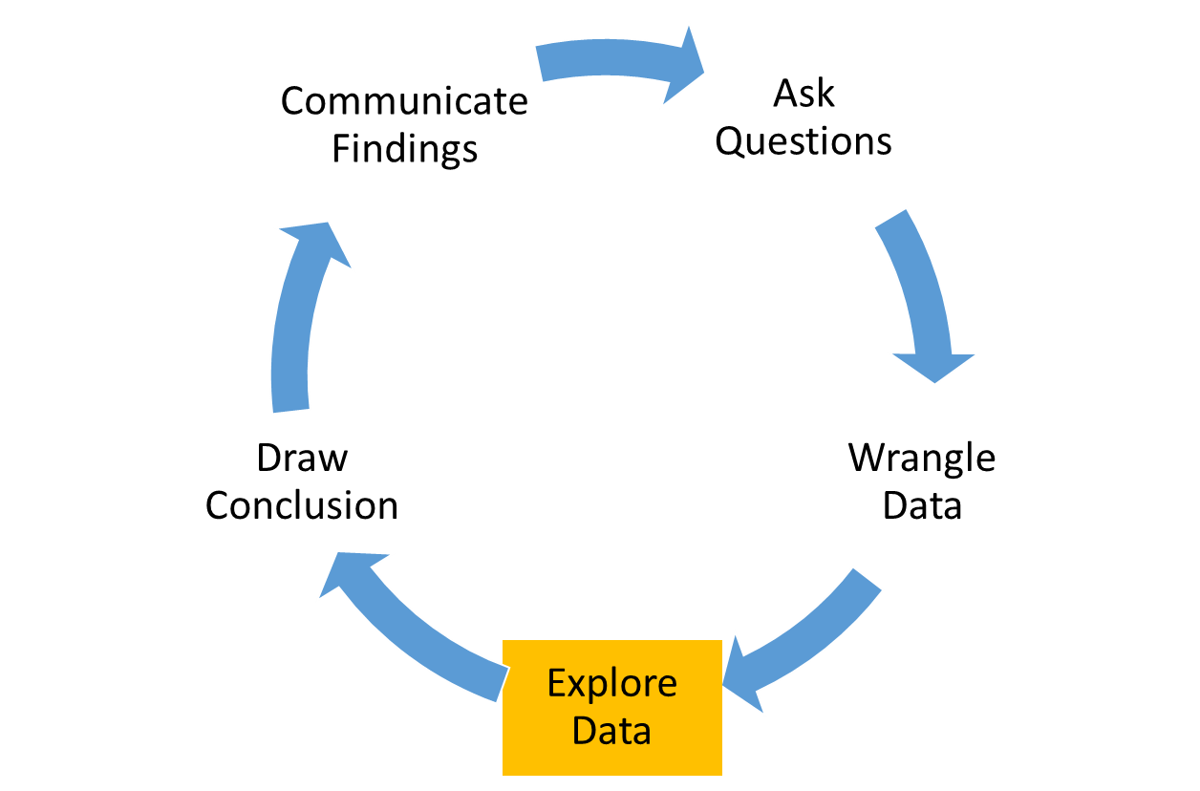
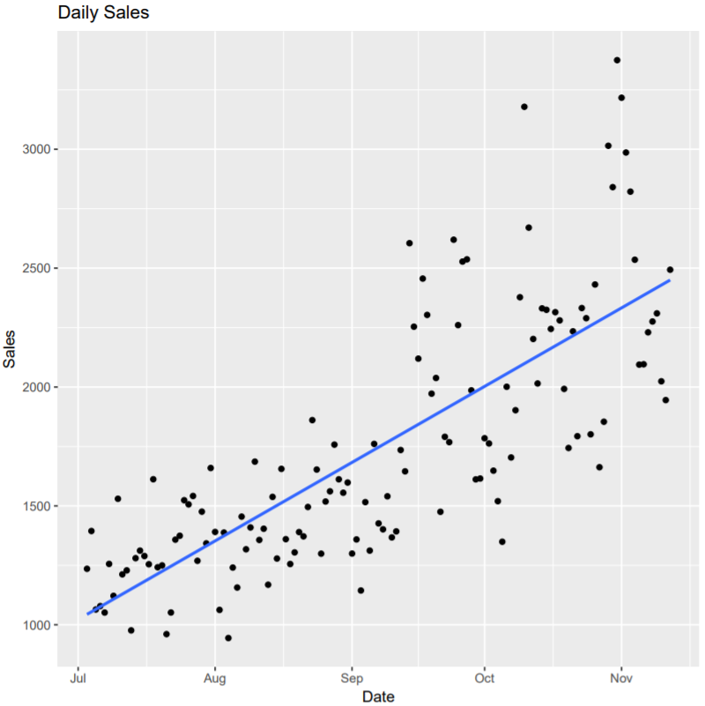
Explore Data
Plot:
Daily Sales by Date
Observations:
Upward Sales Trend!
How can I invest in Kitty litter?

Slide 8
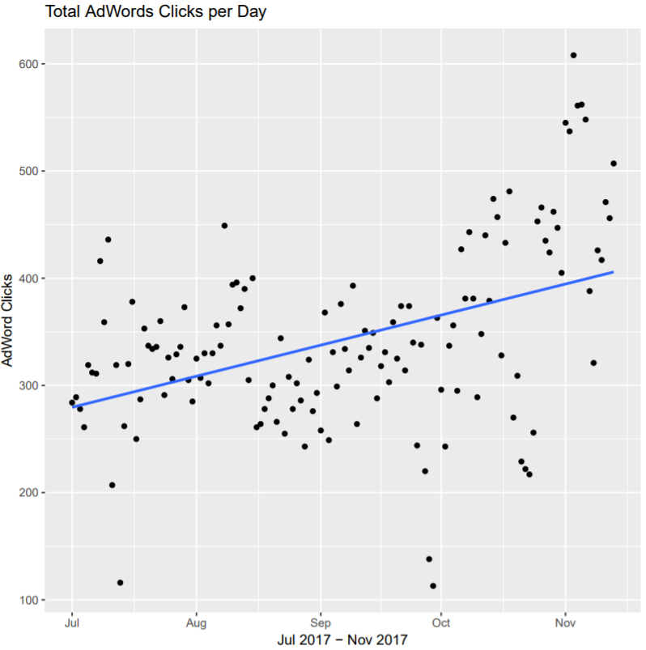
Plot:
Adword Clicks by Date
Observations:
Upward trend!

Slide 9
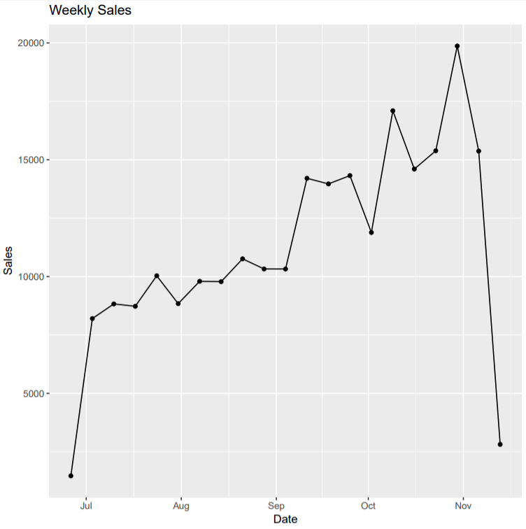
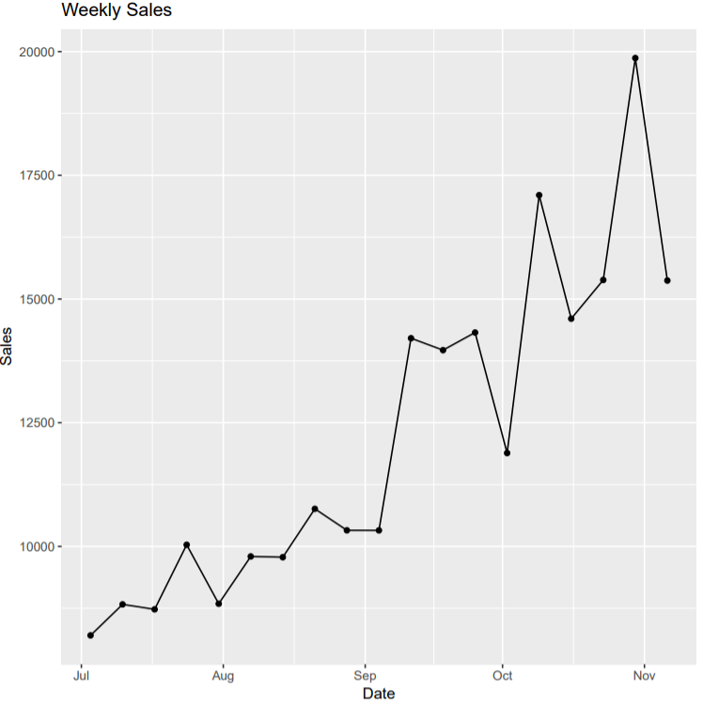
We trimmed the partial weeks of sales (first and last of dataset)

Slide 10
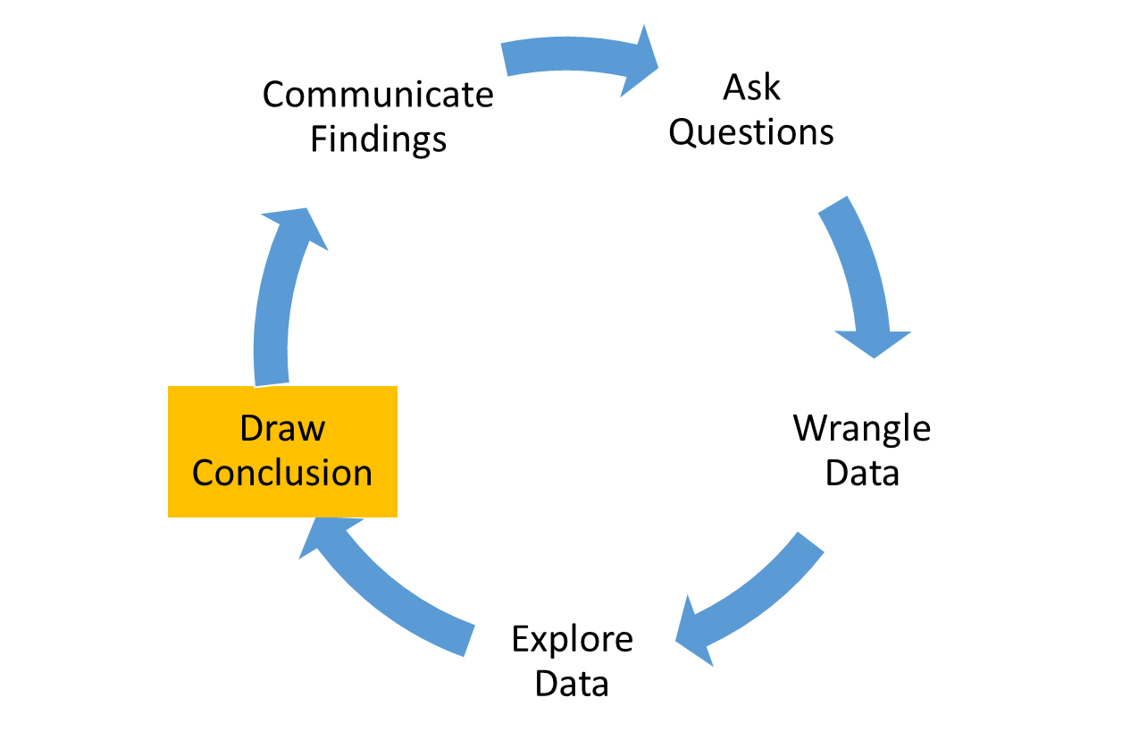
Draw Conclusion(s)
To verify our observations, we took it a step further and analyzed the correlation between Revenue and AdWord Cost, and did a regression analysis on Revenue, AdWord Cost, and time.

Slide 11
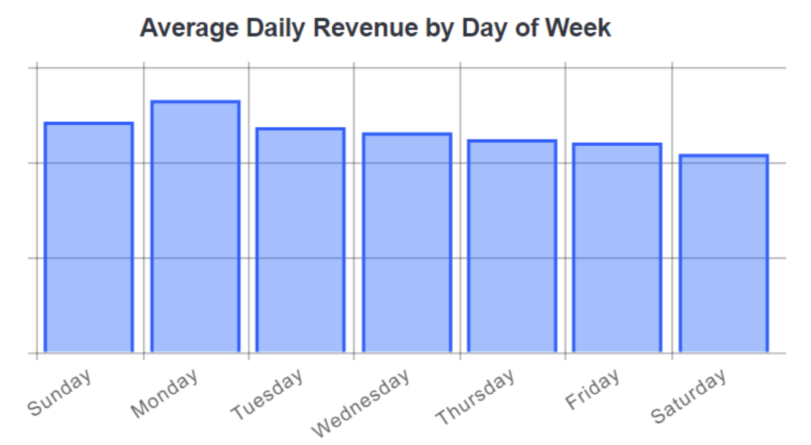
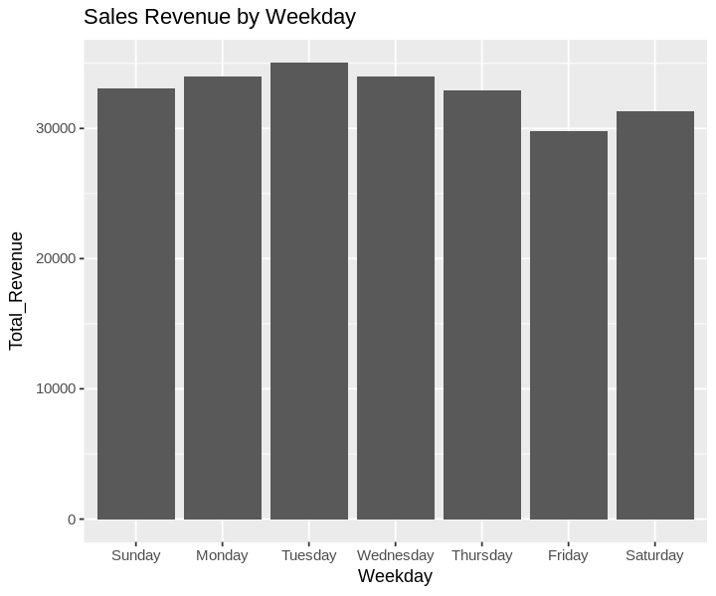
Kitty Litter Revenue aligns with market trends. Sales are higher on Mondays!
https://www.workarea.com/blog_entries/trends-when-do-people-shop-online-updated-for-2017

Slide 12
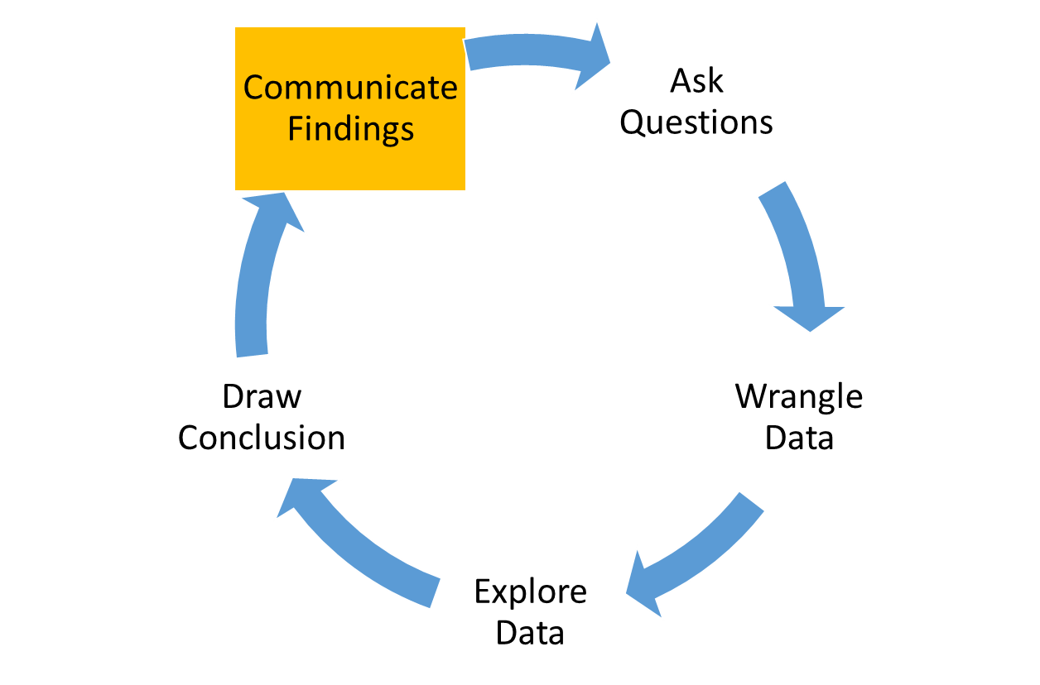
Communicate Findings
Our Question
Does Google AdWord spend have an impact on Sales?
Answer
Aligned upward trend: Adword spend & Sales Revenue
Moderate correlation between Revenue and Adword spend
Regression analysis results show a positive relationship, but AdWord spend is not statistically significant.
The time variable suggests the product popularity is increasing, as well as an increased online shopping preference
Recommendations (to OxiScience)
Standardize product naming convention in Amazon
Focus on top 3 products (they generate over 85% of Revenue)
Reconsider current investment on Adwords: cap overall spending and limit spending on certain weekdays
Consider A/B testing on effectiveness of certain keywords

Slide 13
R Code

Slide 14
Appendix: Regression Analysis
Cost t-stat indicates not statistically significant

Slide 15
Appendix: Time Trend

